Slide 1

Geometry
Unit 6, Lesson H1 Proving All Circles Are Similar Volume 1, pg. 317

Slide 2


Benchmark
MA.912.GR.6.5
Apply transformations to prove that all circles are similar.
volume 1, pg. 317

Slide 3
Integrated Mathematical Thinking and Reasoning Standards
MA.K12.MTR.1.1 Actively participate in effortful learning both individually and collectively.
MA.K12.MTR.4.1 Engage in discussions that reflect on the mathematical thinking of self and others.
MA.K12.MTR.5.1 Use patterns and structure to help understand and connect mathematical concepts.
MA.K12.MTR.6.1 Assess the reasonableness of solutions.
volume 1, pg. 317

Slide 4

Learning Target
I can justify that two circles are similar and conclude that any circle can be mapped to another circle using similarity transformations.
volume 1, pg. 317

Slide 5

Warm-Up
volume 1, pg. 318

Slide 6
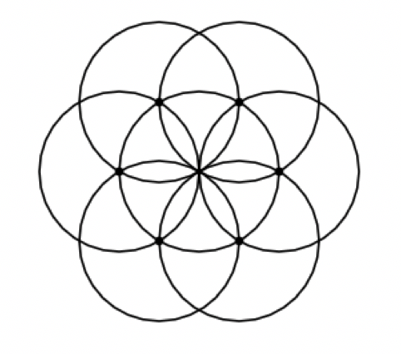
6.H1.1 Warm-Up: Notice and Wonder
What do you notice?
What do you wonder?
volume 1, pg. 318

Slide 7

Exploration
volume 1, pg. 318

Slide 8

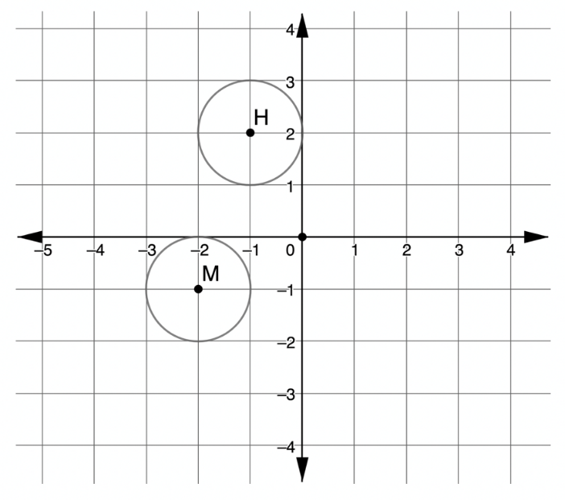
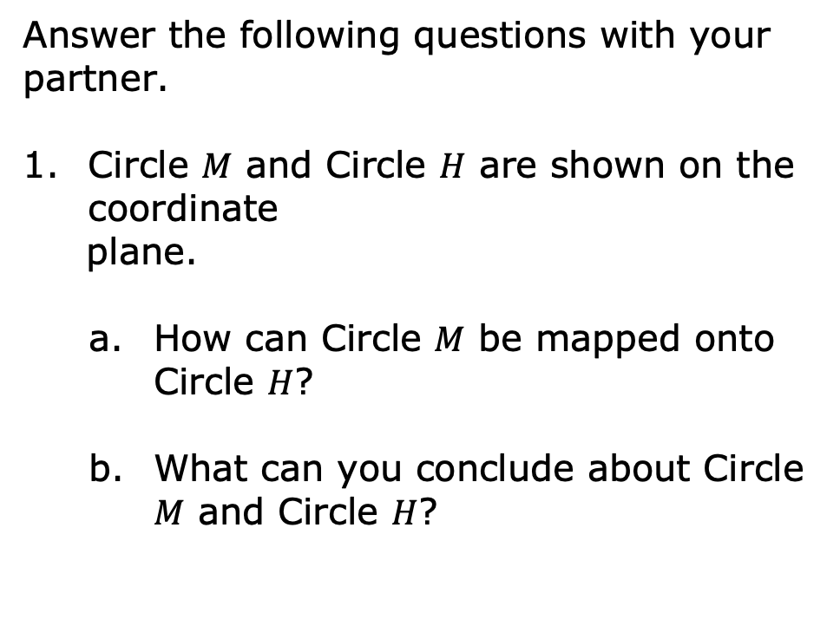
6.H1.2 Exploration: Are Circles Similar?
Answer the following questions with your partner.
Circle $M$ and Circle $H$ are shown on the coordinate
plane.
How can Circle $M$ be mapped onto Circle $H$?
What can you conclude about Circle $M$ and Circle $H$?
volume 1, pg. 318

Slide 9
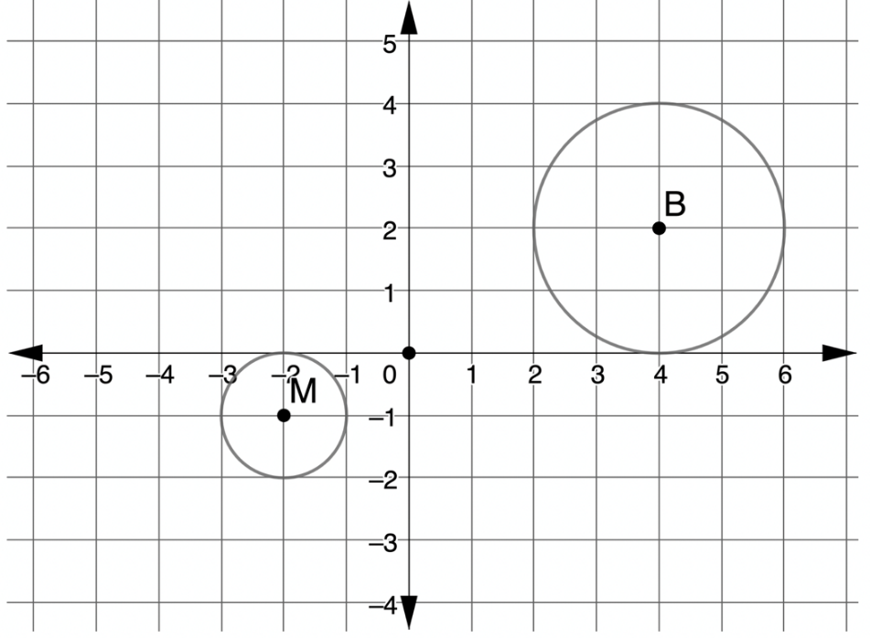

Circle $M$ and Circle $B$ are shown on the coordinate plane.
How can Circle $M$ be mapped onto Circle $B$?
What can you conclude about Circle $M$ and Circle $B$?
volume 1, pg. 319

Slide 10
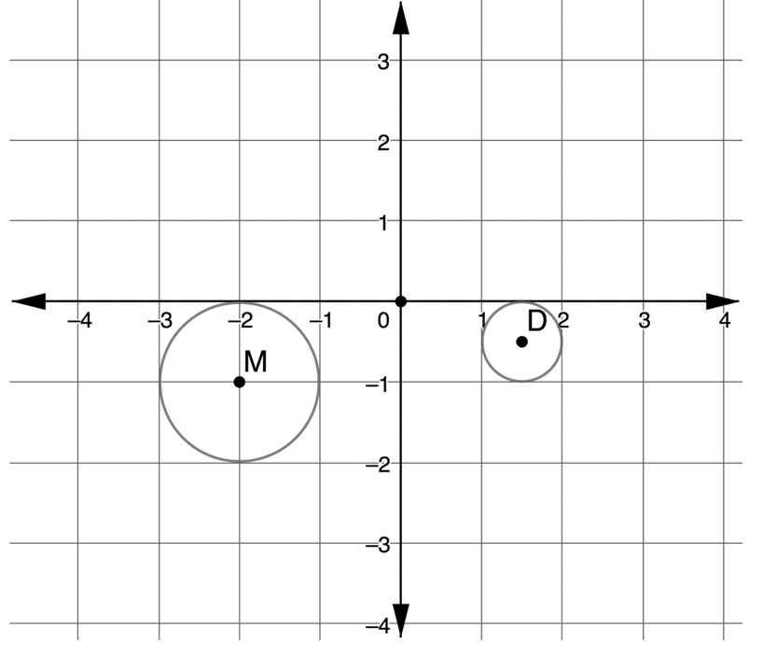

Circle $M$ and Circle $D$ are shown on the coordinate plane.
How can Circle $M$ be mapped onto Circle $D$?
What can you conclude about Circle $M$ and Circle $D$?
volume 1, pg. 319

Slide 11
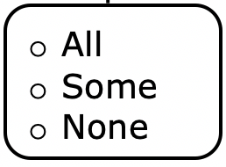
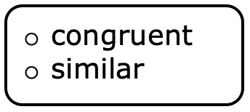
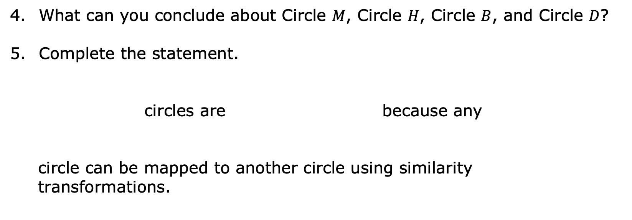
What can you conclude about Circle $M$, Circle $H$, Circle $B$, and Circle $D$?
Complete the statement.
circles are because any
circle can be mapped to another circle using similarity
transformations.
volume 1, pg. 319

Slide 12

Your Turn
volume 1, pg. 320

Slide 13
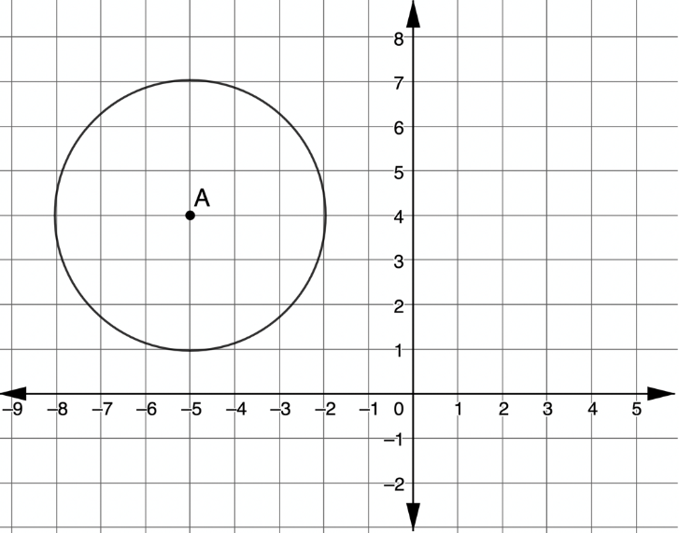

6.H1.3 Your Turn!
Circle $A$ is shown on
the coordinate plane.
Draw Circle $P$, the result of a translation $5$ units right and $2$ units down and a dilation of $\frac{1}{2}$ about the center of Circle $P$.
Explain how Circle $A$ and Circle $P$ are similar. Include the word “transformation” in your explanation.
volume 1, pg. 320

Slide 14
Lana and Henry are writing notes from today’s lesson.
Whose notes do you agree with? Why?
Lana’s Notes | Henry’s Notes
All circles are similar; therefore, all circles are also congruent. | All circles are similar, but not all circles are congruent.
volume 1, pg. 320

Slide 15

Wrap-Up
volume 1, pg. 321

Slide 16
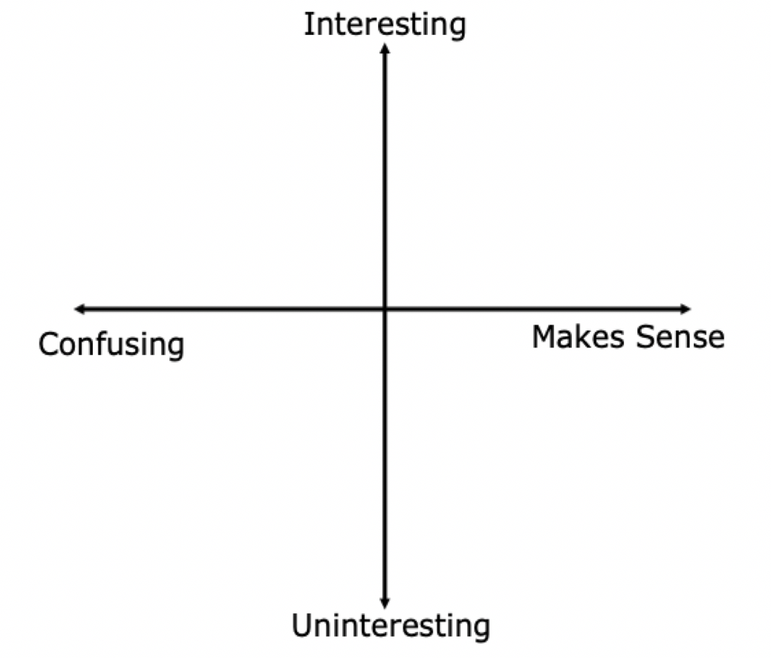
6.H1.4 Wrap-Up: Reflection
Plot a point on the grid below to indicate your level of interest and understanding for today’s learning target.
Explain the location of your point.
volume 1, pg. 321

